Slide 1

Computer Hardware
D.Sakthivel
Assistant Professor & Trainer,
KGiSL Micro College
KGiSL Campus, Coimbatore – 641 035.

Slide 2
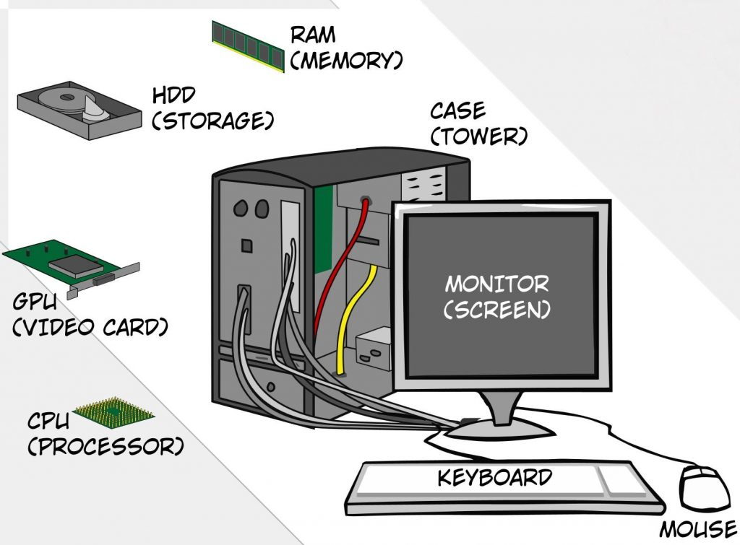
Structure of Hardware

Slide 3
Hardware Introduction
Computer hardware is the Physical Components that a computer system requires to function.
It can be categorized as having Internal and External components.

Slide 4
Internal Components
Motherboard
Processor
RAM
Graphics Card
Hard Disk

Slide 5
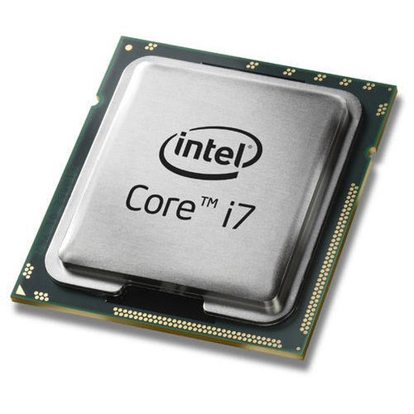
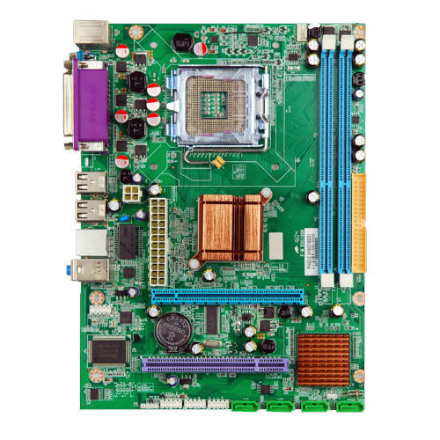
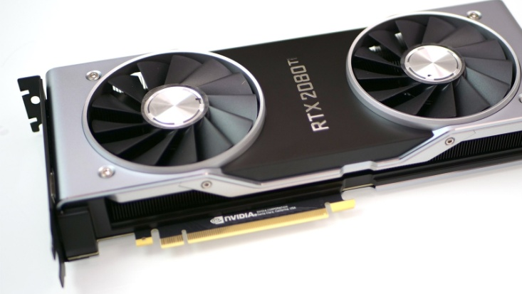
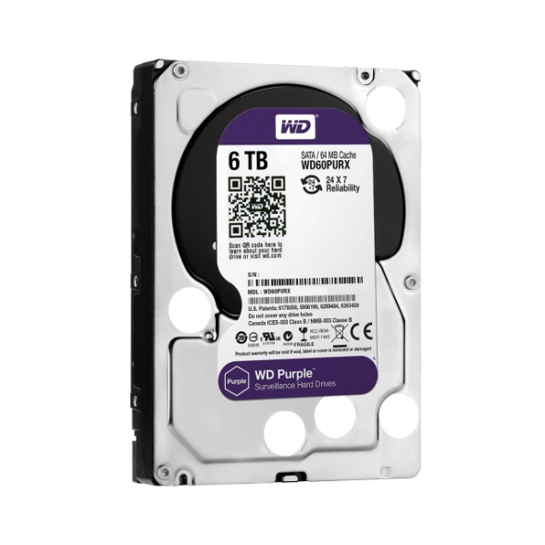
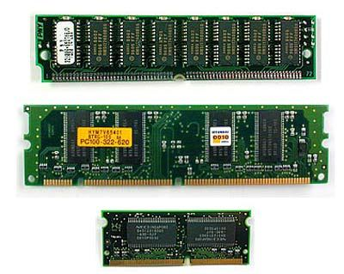
Examples

Slide 6
External Components
Keyboard
Mouse
Monitor
Speakers
USB Drive
Web Camera

Slide 7
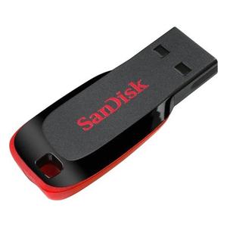
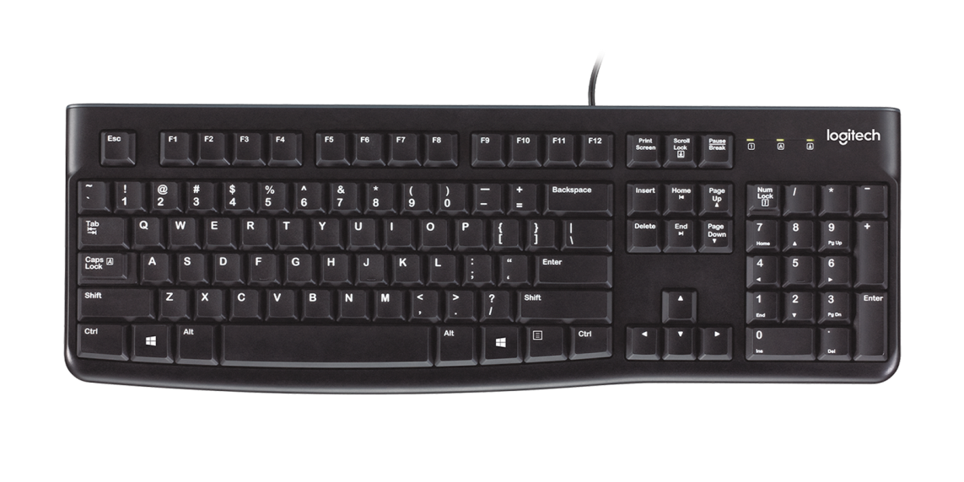
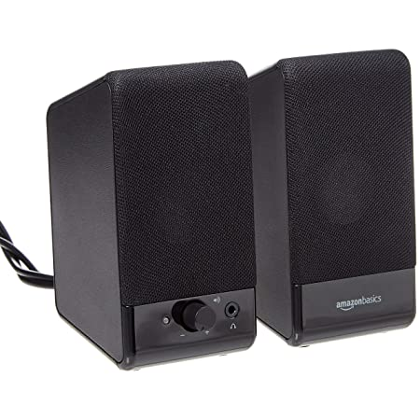
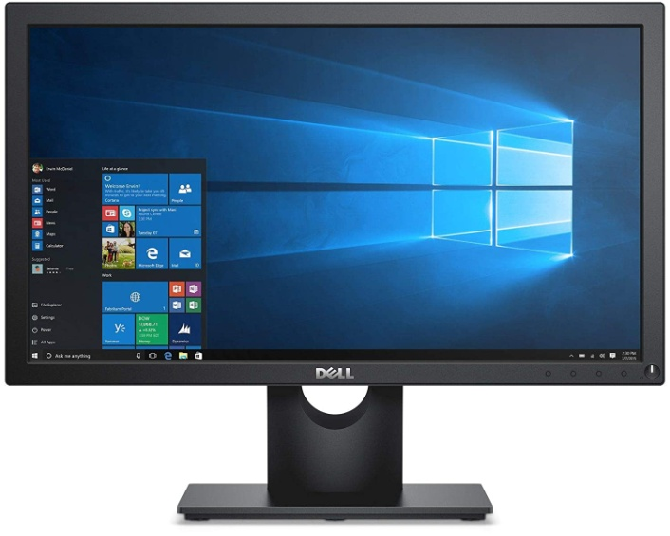
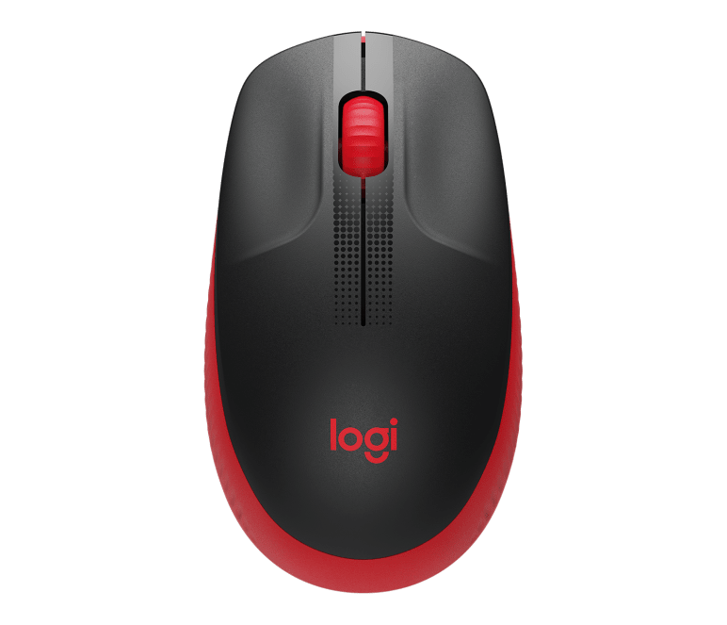
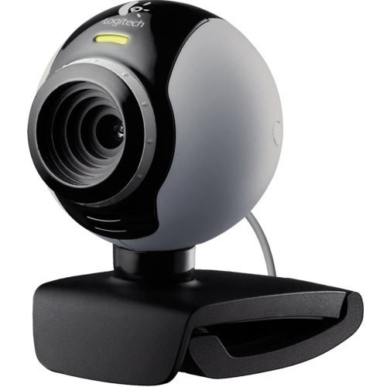
Examples

Slide 8
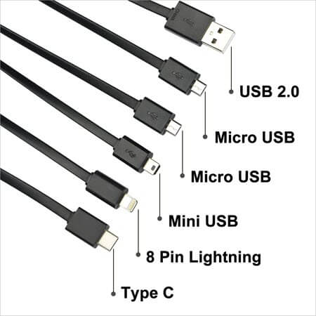
Port
Connectors or Ports allow us to Plug-in different components to a computer to enhance its capabilities.
The video display ports are DVI(Digital Video Interface-Audio,Video), VGA(15pin-Video Grpahic Array Connector).
The video and audio ports are HDMI(High Definition Multimedia Interface), display port.

Slide 9
USB Ports
USB stands for Universal Serial Bus
USB is Designed to standardize many peripheral connections.
USB transfer the Audio , Video and Data Transfer and also Power
Now a days, USB C Type using for Charging, Data Transfer, External Audio, Video Projection

Slide 10
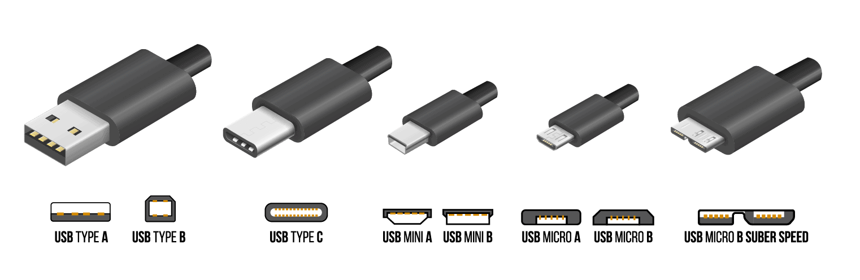
USB Ports

Slide 11
Motherboard
The motherboard serves as a Single Platform to connect all of the parts of a computer together.
It connects the CPU, Memory, Hard Drives, Optical Drives, Video Card, Sound Card, and Other Ports and expansion cards Directly or via Cables.
It can be considered as the Backbone of a computer.

Slide 12
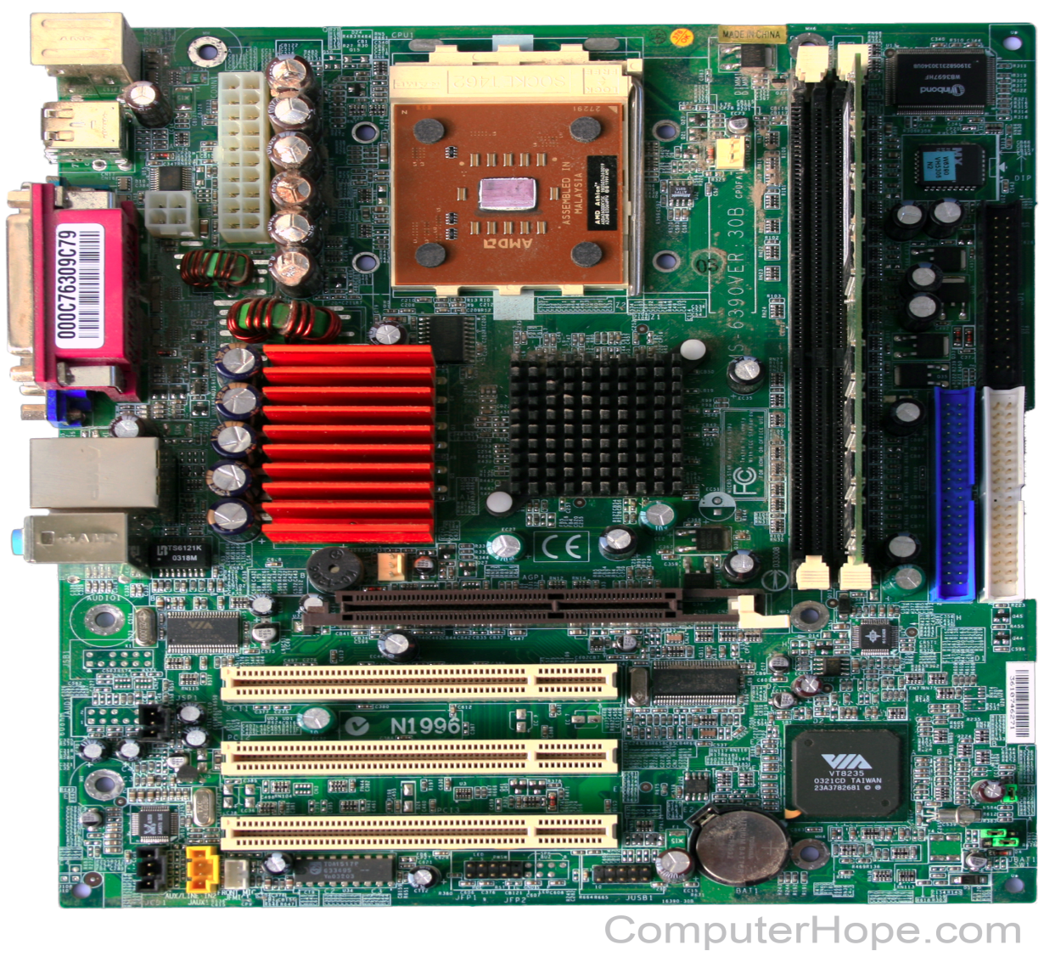
Motherboard

Slide 13
CPU
CPU stands for Central Processing Unit
CPU performs all types of data processing operations.
It stores Data, Intermediate Results, and Instructions (program).
It Controls the operation of all parts of the computer.
CPU is the Brain of the computer.

Slide 14
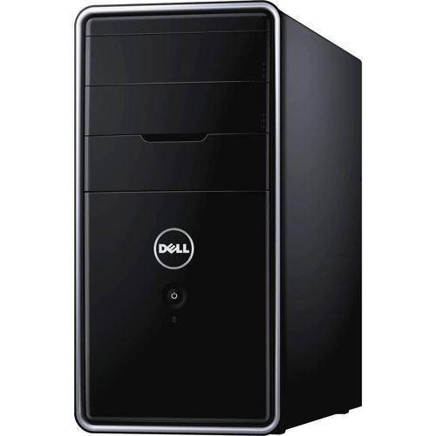
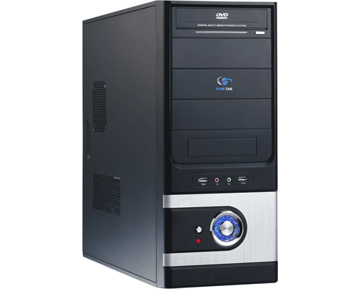
CPU

Slide 15
GPU
GPU stands for Graphics Processing Unit
It is specialized Processor originally designed to accelerate the Graphics Rendering.
GPUs can process many pieces of data simultaneously.
It is used for Machine Learning, Video Editing, and Gaming Applications.

Slide 16
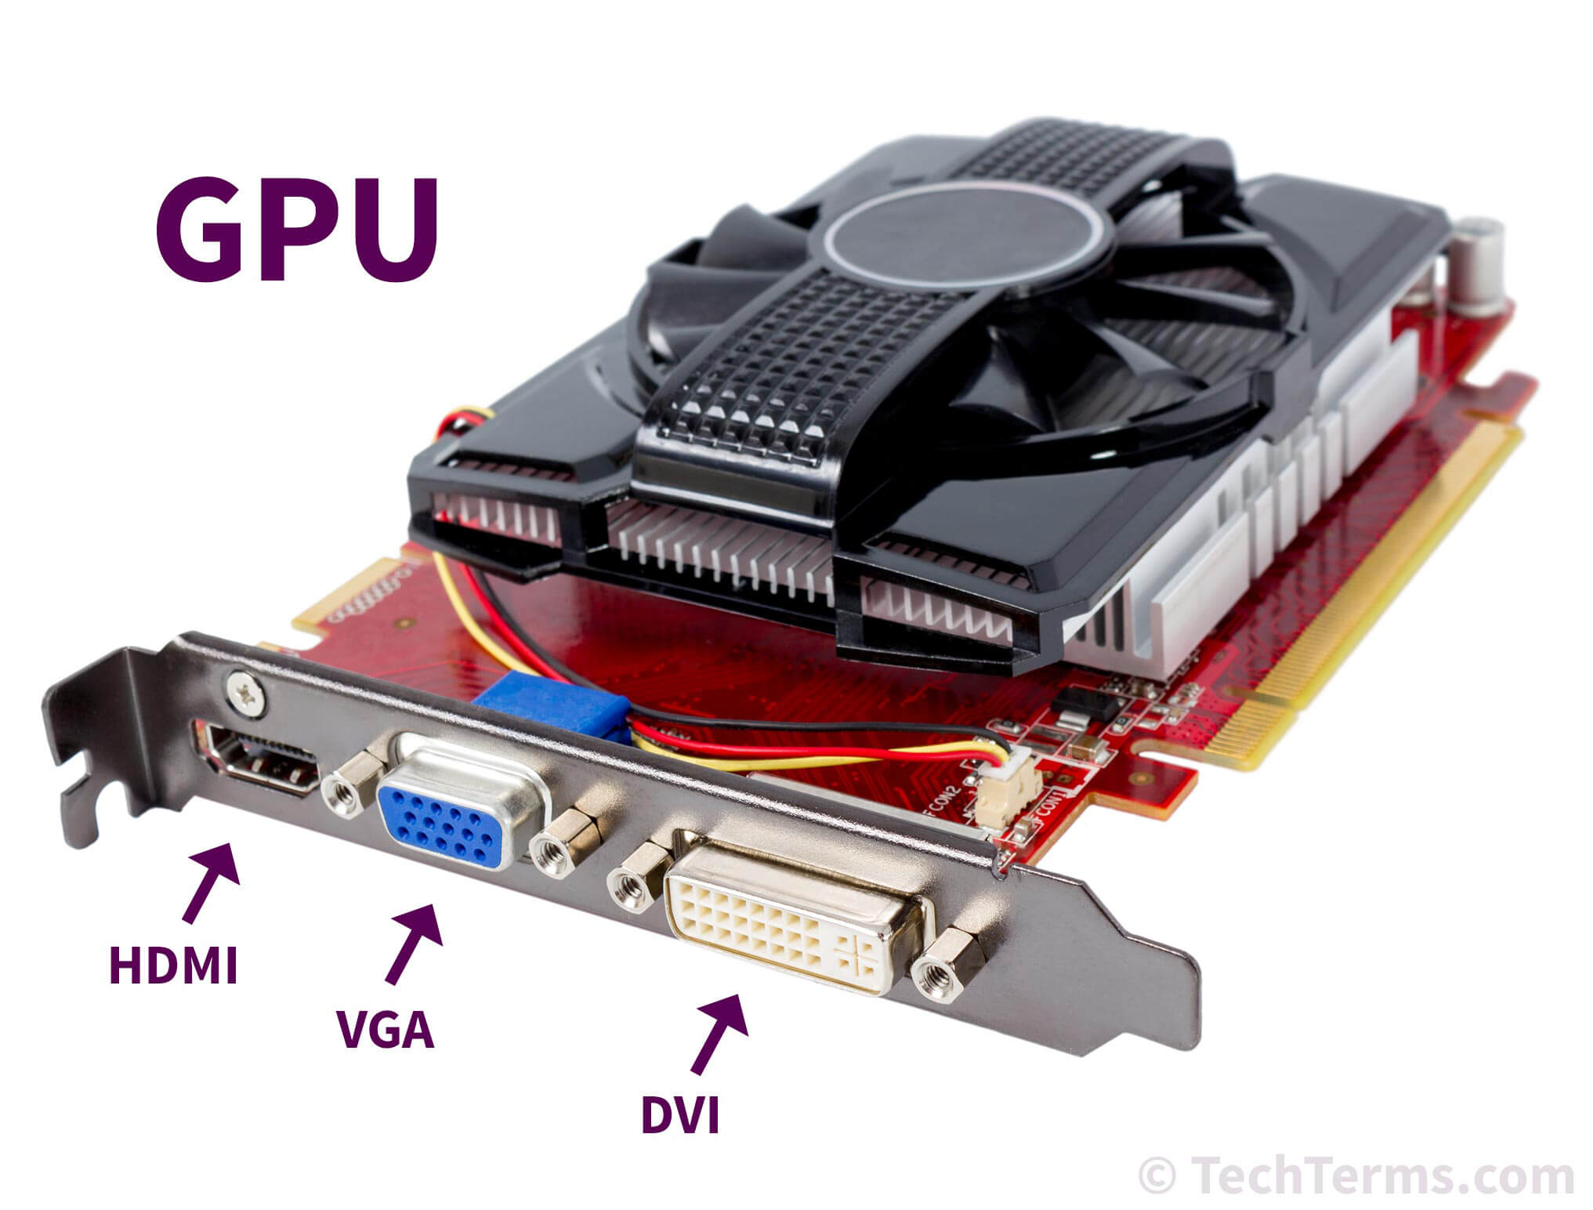
GPU

Slide 17
CPU Instruction Set
Programs on the computer are broken down into very small and simple instructions.
CPU will only perform small operations in binary but lakhs of these operations are done in a Single Second.
Example:
Add two numbers
Load value from Memory Location
Store Value to Memory Location

Slide 18
CPU Clock Speed
One of the performance matrices is Clock Speed which measures the Number of Instructions that the CPU can execute Per Second.
The CPU speed measured in GigaHertz (GHz).
1 GHz = a Billion instructions per second
A higher clock speed means a faster CPU.

Slide 19
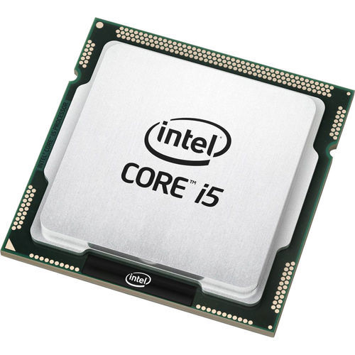
CPU Core(Processor)
A processor (CPU) is the Logic Circuitry that responds to and processes the basic instructions that drive a computer.
The CPU is seen as the main and most crucial integrated circuitry (IC) chip in a computer.
It is responsible for Interpreting most of Computers Commands.

Slide 20
Measurement of Units(Data)
Computers work with a unit of measure called Bytes.
This measure is most commonly used when describing the size of a Storage Media.

Slide 21
Types of Storage Measurements
BYTES
KB
MB
GB
TB

Slide 22
Measurement Size’ S
One Kilo Byte is equal to 1024 Bytes.
One Mega Byte is equal to 1024 Kilo Bytes.
One Giga Byte is equal to 1024 Mega Bytes.
One Tera Byte is equal to 1024 Giga
Bytes.

Slide 23
Examples of Measurement Units
Data
DVD(4.5 GB)
WEB PAGE(3 MB)
MOVIE(500 MB/ 4 GB)
HARD DISK(128 GB)
CD(720 MB)
MP3 SONG(4 MB)

Slide 24
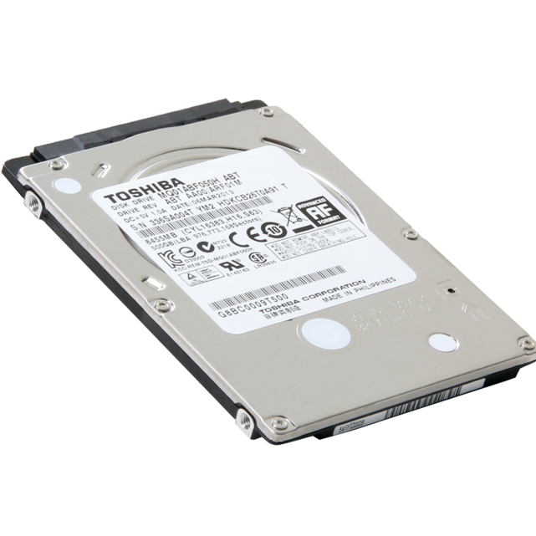
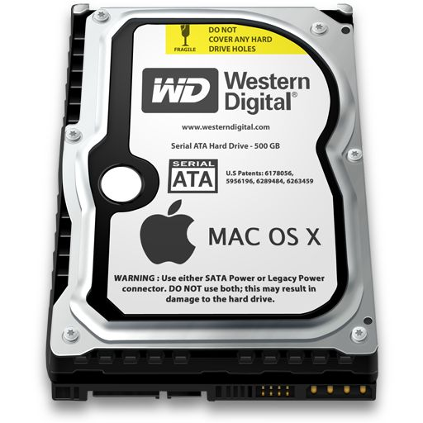
Hard Drives
The hard drive is Non-volatile storage which is responsible for storing Permanent and Temporary data.
SSD (Solid-state drives) is 25 times faster than regular HDDs (Hard-disk drives)

Slide 25
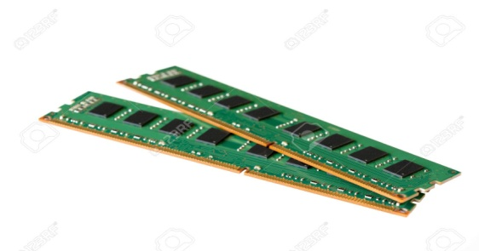
RAM
RAM is stands for Random Access Memory
RAM is also another type of storage, we can store photos, videos, etc.
The RAM is measured in GB we might have heard a lot of times that 2GB RAM, 4GB RAM in Phones, Laptops, etc.
RAM is Volatile Memory means the data remains in RAM if the computer is on, but it's lost when the computer is turned off.
RAM is much faster to Read and Write than other types of storage.
Volatile memory can be Changed, Upgraded, or Expanded easily by Users.

Slide 26
ROM
ROM is stands for Read Only Memory
ROM is a Non-Volatile Memory, which means the information is permanently stored on the chip.
Non-volatile memory Cannot be Changed by Users.
ROM is also another type of storage, we can store photos, videos, etc.

Slide 27
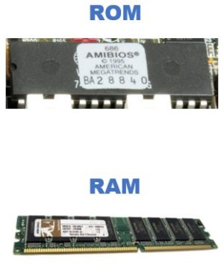
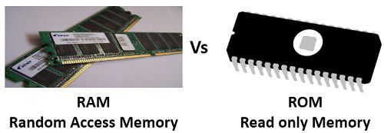
RAM Vs ROM

Slide 28
RAM verses Hard-Drives
RAM | Hard-Drives
RAM is a Volatile Memory | Hard-Drives is a Non Volatile Memory
Relatively Expensive | Relatively Cheaper
Faster Data Access | Relatively Slower Access

Slide 29
Registers
Registers are a type of Computer Memory.
It is used to quickly accept, store, and transfer data and instructions that are being used immediately by the CPU.
They are extremely Fast and extremely Expensive.
A register Temporarily Holds Frequently used Data, instructions, and memory address that are to be used by CPU
They are available in very Little Storage, like Usually in MBs.

Slide 30
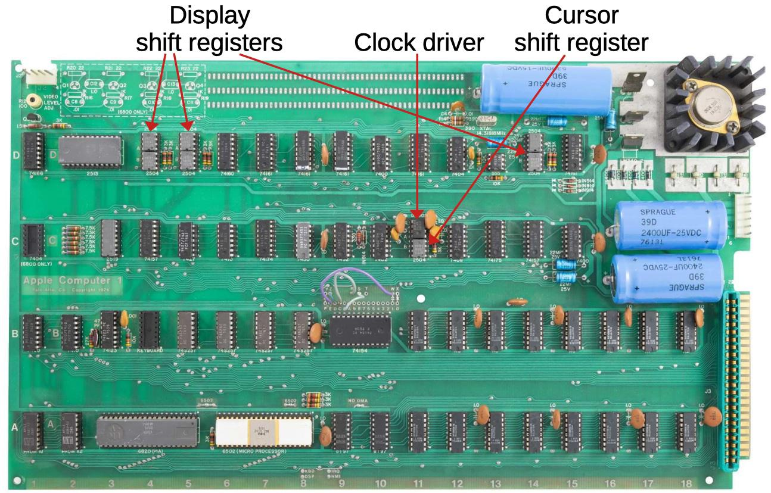
Register Structure

Slide 31
Data Access Times in RAM, Hard-Disk, Registers
Storage Devices | Access Times | Data Transfer Speed
Registers | < 2 nano seconds | 100 GB/S
RAM | ~ 100 nano seconds | 10GB/S
Hard-Disk | ~ mill seconds | 1000MB/S

Slide 32
Operating System Processor
A 32-bit processor includes a 32-bit register.
A 64-bit processor includes a 64-bit register.

Slide 33
32 Bit Processor
Address upto 4 GB RAM
Cheaper
Requires More Time to Process and Response
Limited Processing
Slower and Less Secure

Slide 34
64 Bit Processor
Address upto 16 Exabytes of RAM
Expensive
Requires Minimum Time to Process and Response
Multi-Tasking
Faster and More Secure

Slide 35
Graphics Card
A graphics card provides high-quality visual display by processing and executing graphical data using advanced graphical techniques, features and functions.
A graphics card is also known as a Graphics Adapter, Graphics controller, Graphics Accelerator card or Graphics Board.
Graphics Card can be integrated within the Motherboard or be added on as an Extension Card.
Example:

Slide 36
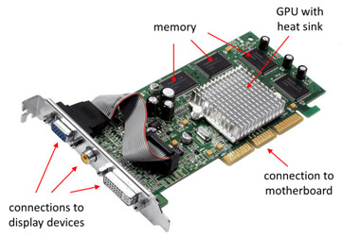
Graphics Card Structure

Slide 37
CPU verses GPU
Central Processing Unit | Graphics Processing Unit
CPU is suitable for Serial instruction processing. Few Cores[2-8] | GPU is suitable for Parallel instruction processing. More Cores[1000]
CPU is less than GPU speed | GPU is faster than CPU
CPU consumes or needs more memory than GPU. | GPU consumes or requires less memory than CPU.

Slide 38
BIOS
BIOS stands for Basic Input/Output system
It’s Data stored in ROM/Flash Memory.
It’s enables and disable the certain system components.
Select the Boot Drives, Users can perform the Hardware Configuration.
It’s ensure that the Hardware Devices are functioning correctly.

Slide 39
BIOS Functionalities
System Clock
Boot Drives
H/W Configuration
Enable/Disable System Components
Secured Access

Slide 40
UEFI
UEFI stands for Unified Extensible Firmware Interface
It is support the Latest Hardware.
It performs the Secure and Faster boot.
It initializes the hardware and loads the operating system into the memory.

Slide 41
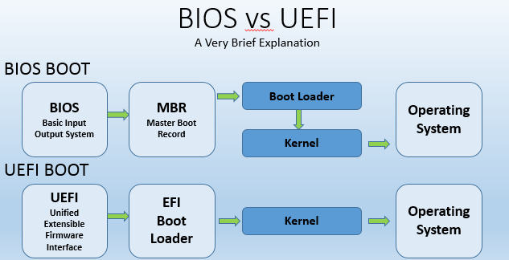
BIOS Vs UEFI
BOOTING PROCESS

Slide 42



